Slide 1
FAKE NEWS PREDICTION USING MACHINE LEARNING
PRESENTED BY:
T C DHARSHAN(2023006380)
D MUKESH(2023003986)
SAMEER(2023004759)

Slide 2
INTRODUCTION
Fake news is false, misleading, or fabricated content that lacks verified sources.
Rapid growth due to social media platforms.
Fake news prediction uses machine learning to classify the news articles as "real" or "fake" by analyzing textual patterns, identifying misinformation, and reducing manual verification.
Algorithm used: Logistic Regression

Slide 3
LOGISTIC REGRESSION
Logistic regression is a fundamental machine learning algorithm used for binary classification.
It predicts one of two outcomes (0 or 1, true/false, yes/no) based on predictor variables.
It uses the sigmoid function to map predicted values to probabilities between 0 and 1

Slide 4
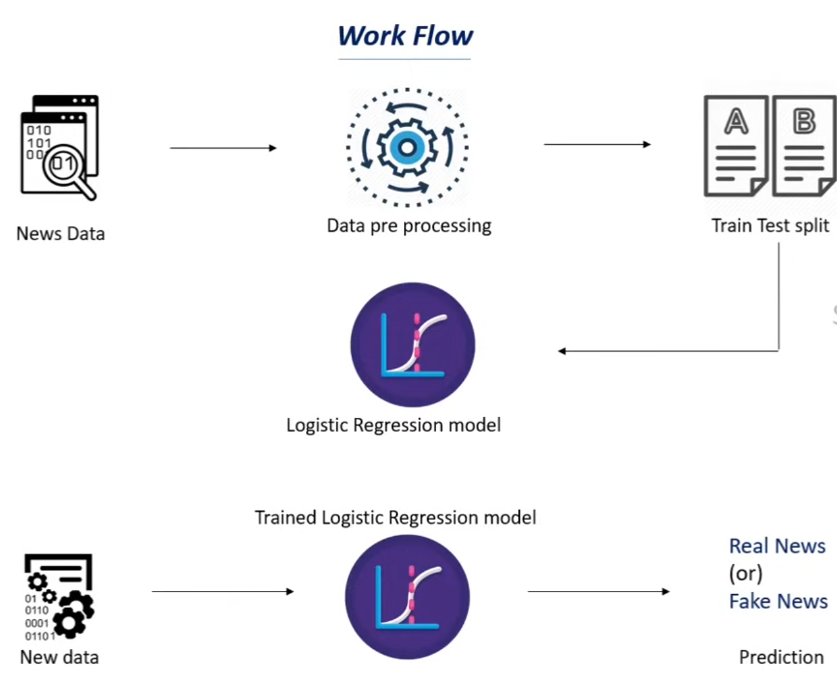
WORKFLOW

Slide 5
Why Logistic Regression?
Suitability: It is ideal for binary classification tasks, making it a standard choice for classifying text as "fake" or "real"
Performance: It provides high accuracy (up to 98.31%) and efficiency in text classification tasks.
Interpretability: Logistic regression allows for easy understanding of which words or features contribute most to the classification.

Slide 6
DATA SET
Source: Kaggle / online datasets
Contains:
News title
Text/content
Label (Real/Fake)
Data preprocessing:
Remove stopwords
Lowercasing
Removing punctuation

Slide 7
Model Training
Split dataset:
Training set (80%)
Testing set (20%)
Train Logistic Regression model
Evaluate using:
Accuracy → Overall correctness
Precision → Correct positive predictions
Recall → Coverage of actual positives
F1-score → Balance between precision & recall

Slide 8
RESULTS
Model accuracy (example: 90–95%)
Confusion Matrix:
True Positives
False Positives
Observations:
Model performs well on structured news
May struggle with sarcastic or ambiguous text

Slide 9
CONCLUSION
Logistic regression is a highly effective, efficient, and interpretable machine learning algorithm for binary fake news classification (real vs. fake).
It often achievies high accuracy rates,sometimes exceeding 98% when combined with TF-IDF vectorization and Natural Language Processing (NLP) techniques.
It acts as a powerful, scalable solution for identifying patterns in misinformation on social platforms

